Slide 1
Efficient Algorithms
Ekkapot Charoenwanit
Electrical and Computer Engineering (ECE)
TGGS
KMUTNB

Slide 2
Lecture 14: State Space Search
Brute Force
Backtracking
Branch & Bound

Slide 3
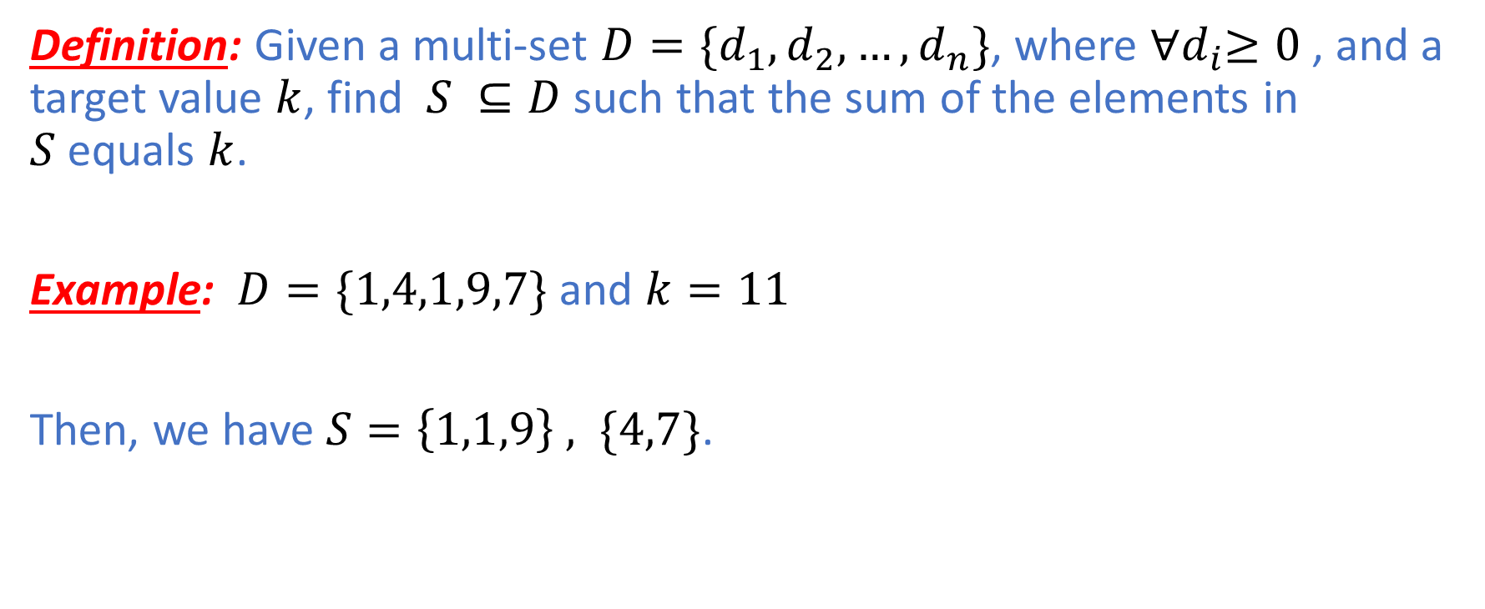
Subset Sum
Definition: Given a multi-set $D=\{d_{1},d_{2},…,d_{n}\}$, where ${∀d}_{i}≥0$, and a target value $k$, find $S ⊆D$ such that the sum of the elements in $S$equals $k$.
Example: $D=\{1,4,1,9,7\}$ and $k=11$
Then, we have $S=\left\{1,1,9\right\} , \{4,7\}$.

Slide 4
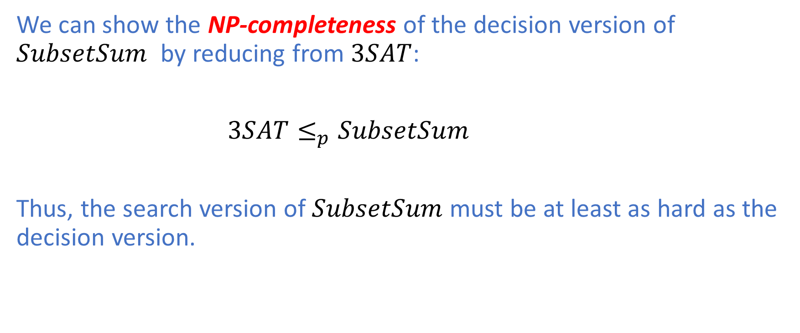
Subset Sum: NP-Hard
We can show the NP-completeness of the decision version of $SubsetSum$ by reducing from $3SAT$:
$3SAT≤_{p}SubsetSum$
Thus, the search version of $SubsetSum$ must be at least as hard as the decision version.

Slide 5
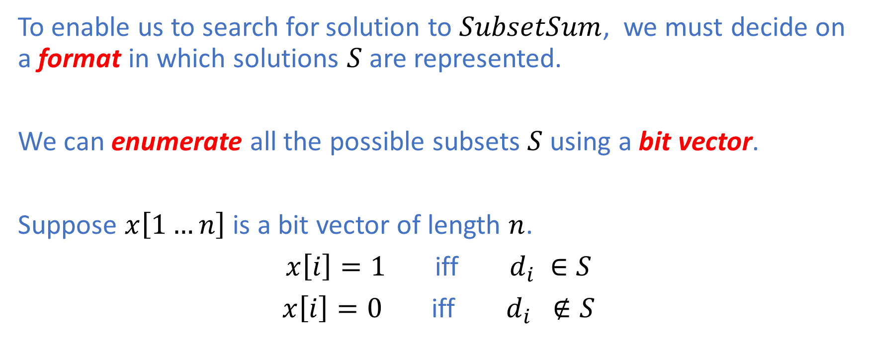
Subset Sum: Subset Enumeration
To enable us to search for solution to $SubsetSum$, we must decide on a format in which solutions $S$ are represented.
We can enumerate all the possible subsets $S$using a bit vector.
Suppose $x\left[1…n\right]$ is a bit vector of length $n$.
$x\left[i\right]=1$ iff $d_{i} ∈S$
$x\left[i\right]=0$ iff $d_{i} ∉S$

Slide 6
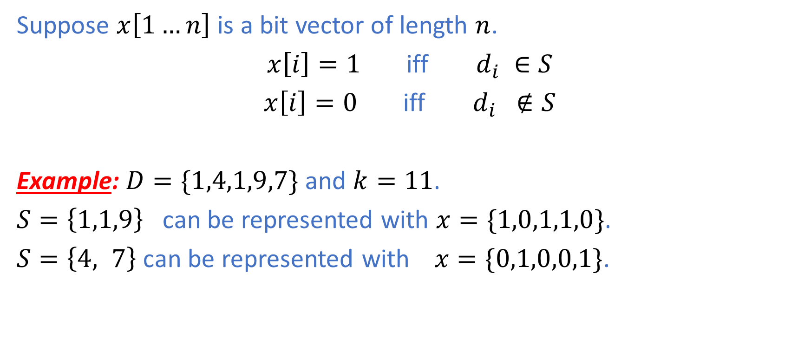
Subset Enumeration
Suppose $x\left[1…n\right]$ is a bit vector of length $n$.
$x\left[i\right]=1$ iff $d_{i} ∈S$
$x\left[i\right]=0$ iff $d_{i} ∉S$
Example: $D=\{1,4,1,9,7\}$ and $k=11$.
$S=\left\{1,1,9\right\}$ can be represented with $x=\{1,0,1,1,0\}$.
$S=\left\{4, 7\right\}$ can be represented with $x=\{0,1,0,0,1\}$.

Slide 7
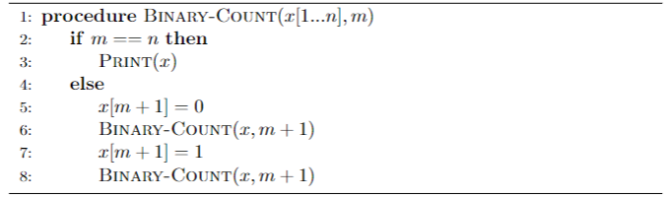
Subset Enumeration: Binary Counter

Slide 8
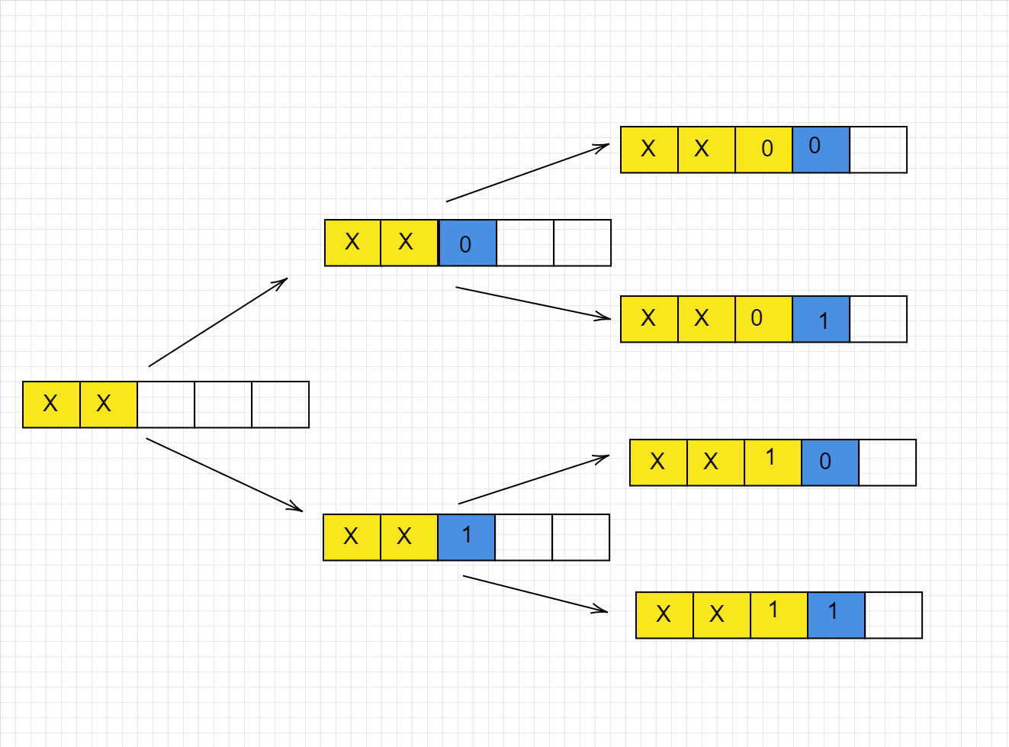
Subset Enumeration: Binary Counter

Slide 9
DFS and BFS
We can enumerate and evaluate solutions using
Depth-First Search (DFS)
Breadth-First Search (BFS)
DFS or BFS visits graphs or trees generated at runtime by the algorithm in question:
Each state is represented by a vertex
A decision is represented by an edge connecting one state to another adjacent state
If DFS is implemented via recursion, stack frames can represent states, generated by corresponding recursive calls.

Slide 10
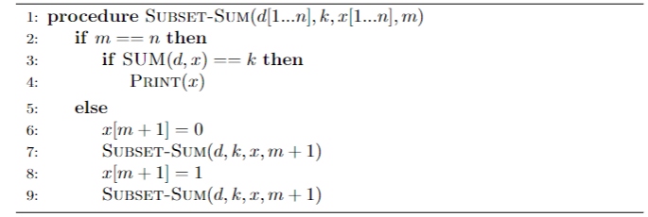
Subset Sum: Recursive DFS

Slide 11
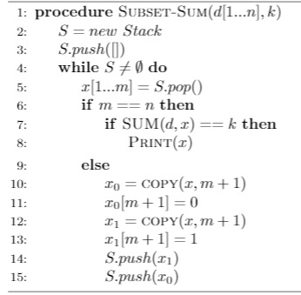
Subset Sum: Iterative DFS

Slide 12
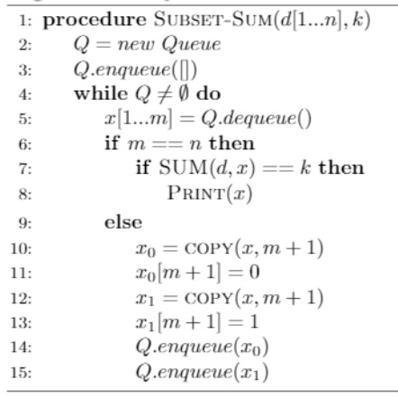
Subset Sum: BFS

Slide 13
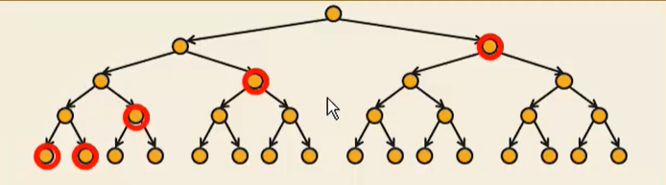
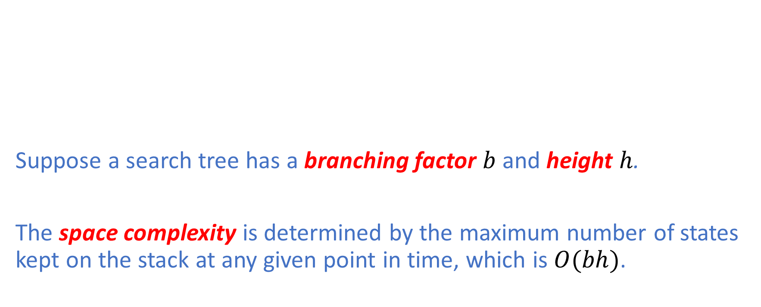
DFS: Memory Consumption
Suppose a search tree has a branching factor $b$ and height $h$.
The space complexity is determined by the maximum number of states kept on the stack at any given point in time, which is $O(bh)$.

Slide 14
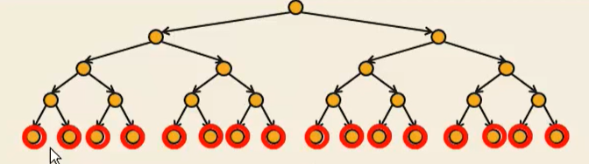

BFS: Memory Consumption
Suppose a search tree has a branching factor $b$ and height $h$.
The space complexity is determined by the maximum number of states kept on the stack at any given point in time, which is $O(b^{h})$.

Slide 15
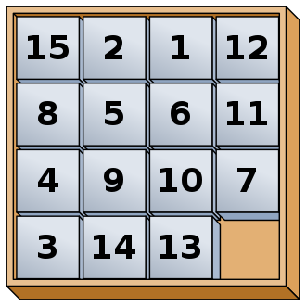
15-Puzzle
Given the following instance of the 15-Puzzle, we would like to solve the puzzle in the fewest number of moves possible.
Which graph traversal technique would you choose? BFS or DFS?

Slide 16
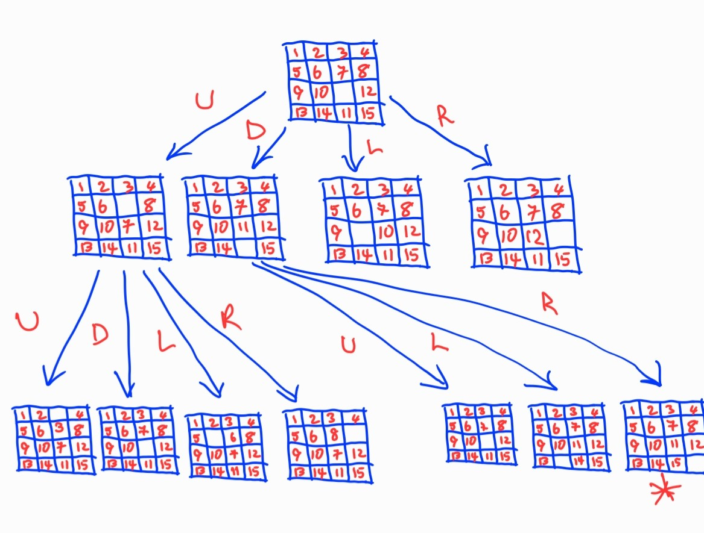
15-Puzzle
Recall that BFS always finds a shortest path from a starting vertex to each reachable vertex in a graph.
Therefore, BFS will solve the 15-Puzzle in the fewest number of moves.

Slide 17
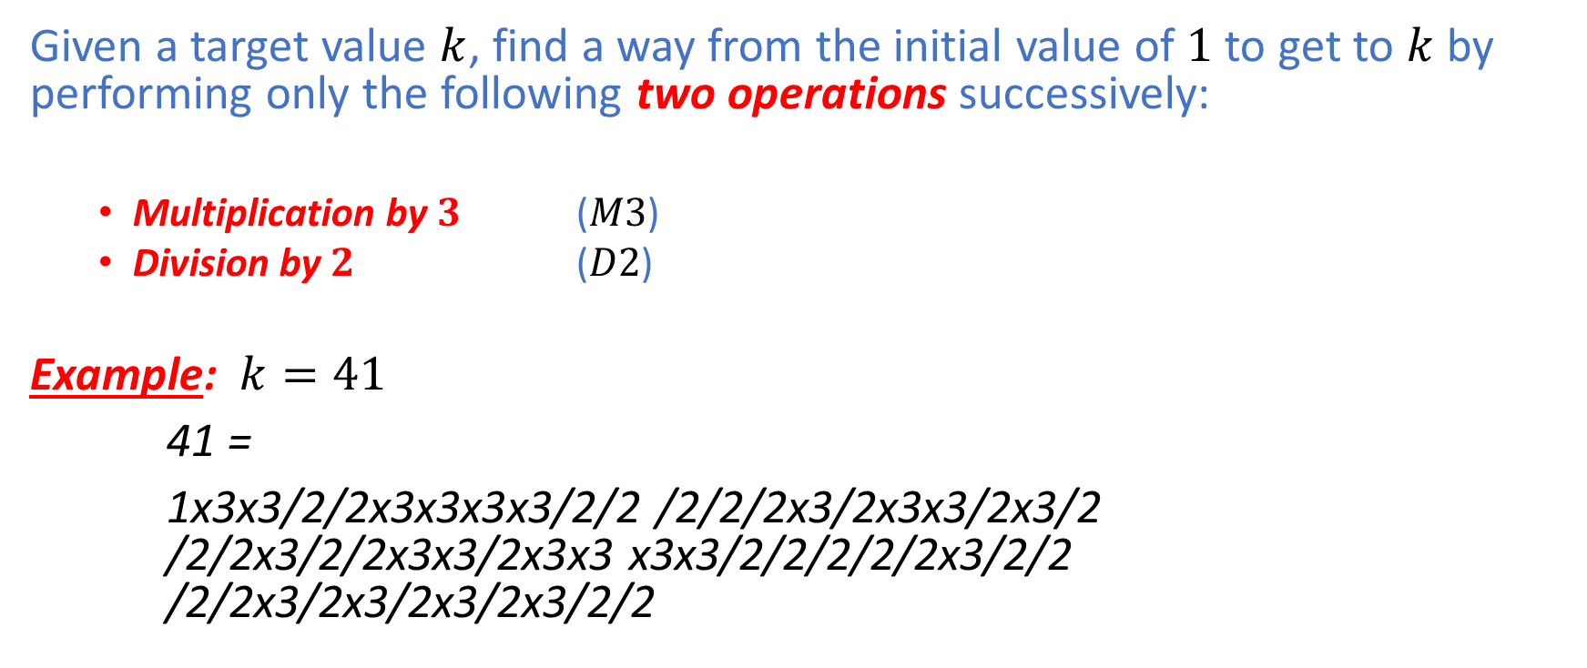
M3D2
Given a target value $k$, find a way from the initial value of $1$ to get to $k$ by performing only the following two operations successively:
Multiplication by $3$ ($M3$)
Division by $2$ ($D2$)
Example: $k=41$
41 =
1x3x3/2/2x3x3x3x3/2/2 /2/2/2x3/2x3x3/2x3/2 /2/2x3/2/2x3x3/2x3x3 x3x3/2/2/2/2/2x3/2/2 /2/2x3/2x3/2x3/2x3/2/2

Slide 18
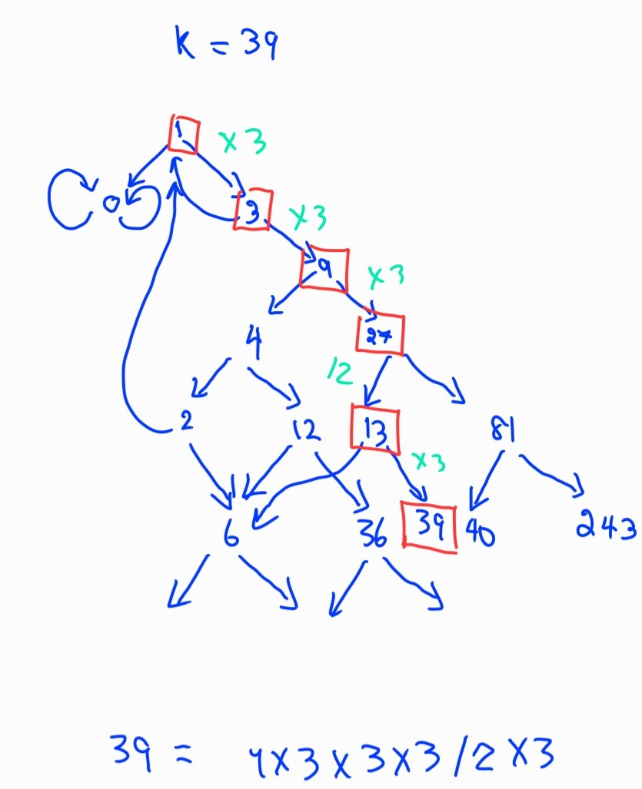

M3D2: BFS
BFS yields the minimum number of operations possible to get to the target value $k$if there exists a way to get to $k$.

Slide 19
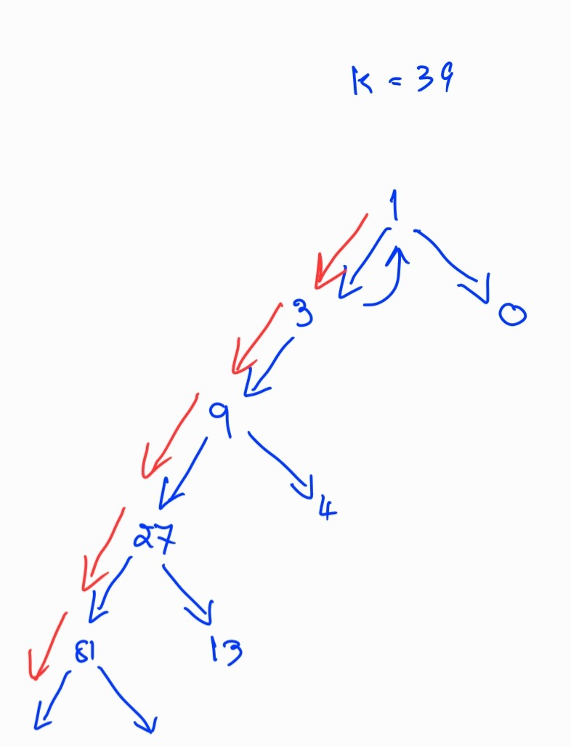

M3D2: DFS
Caveat: With the wrong state space design, DFS may not terminate on some inputs.
Example: Given $k=39$, we choose to perform $M3$ before $D2$.

Slide 20
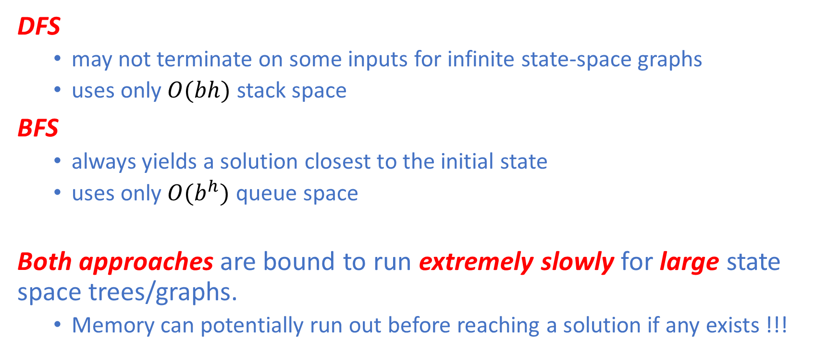
DFS vs BFS: Pros & Cons
DFS
may not terminate on some inputs for infinite state-space graphs
uses only $O(bh)$ stack space
BFS
always yields a solution closest to the initial state
uses only $O(b^{h})$ queue space
Both approaches are bound to run extremely slowly for large state space trees/graphs.
Memory can potentially run out before reaching a solution if any exists !!!

Slide 21
Backtracking
Exploring every solution state can be exponentially slow for large state-space graphs.
By intelligently considering each partial solution state, we can sometimes avoid the need to go further down some subtrees that cannot contain answer states.
Upon detecting such situations, we immediately backtrack and move on to look elsewhere.

Slide 22
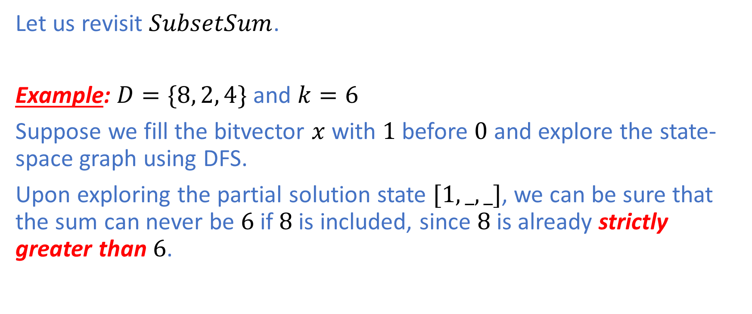
Subset Sum
Let us revisit $SubsetSum$.
Example: $D=\{8, 2, 4\}$ and $k=6$
Suppose we fill the bitvector $x$with $1$ before $0$ and explore the state-space graph using DFS.
Upon exploring the partial solution state $[1,_,_]$, we can be sure that the sum can never be $6$ if $8$ is included, since $8$is already strictly greater than $6$.

Slide 23
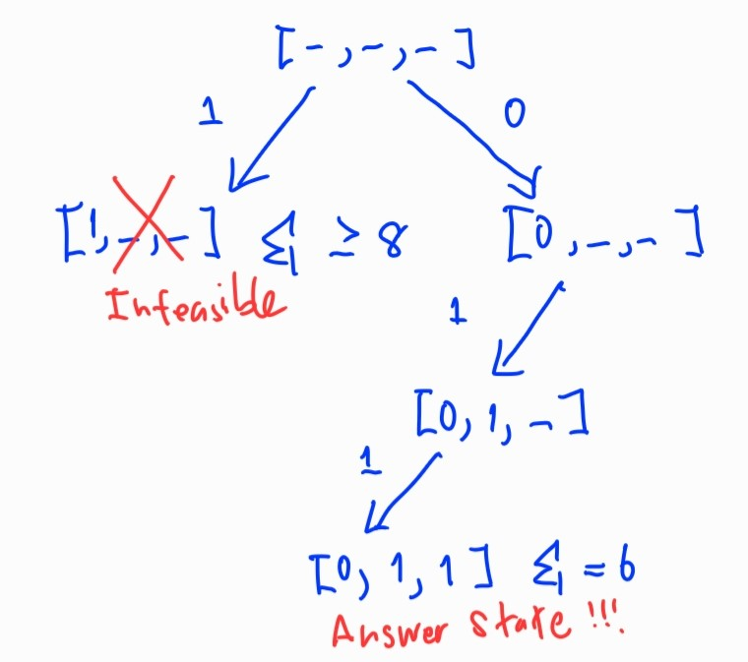
Subset Sum: Backtracking with DFS

Slide 24
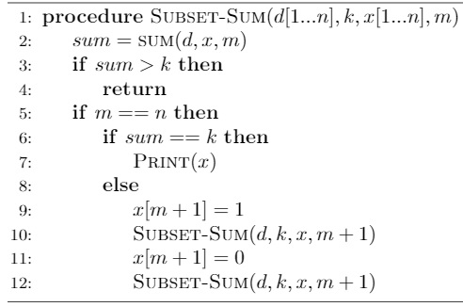
Subset Sum: Backtracking with DFS
Backtracking occurs in lines 3-4.

Slide 25
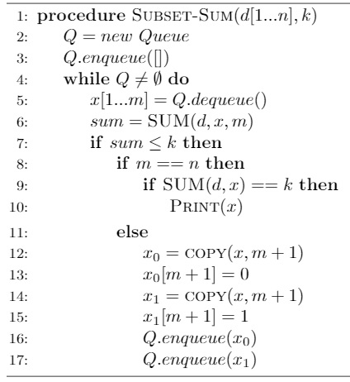
Subset Sum: Backtracking with BFS
Backtracking occurs when the if-statement evaluates to false in line 7.

Slide 26
Backtracking: Lesson Learned
Backtracking can help prune a potentially large state-space graph, thereby cutting down on those exponentially many vertices corresponding to infeasible solutions.
Backtracking can be combined with DFS or BFS to improve the running time as well as memory consumption in a number of NP-Hard search problems whose objectives are to find solutions that satisfy the given constraints.

Slide 27
Branch & Bound
Branch & Bound can help improve both the running time and the memory consumption in algorithms involving NP-Hard optimization problems in a similar manner to Backtracking, which helps improve the running time and memory consumption in algorithms involving search problems.
We can incorporate both Branch & Bound and Backtracking to solve optimization problems.

Slide 28
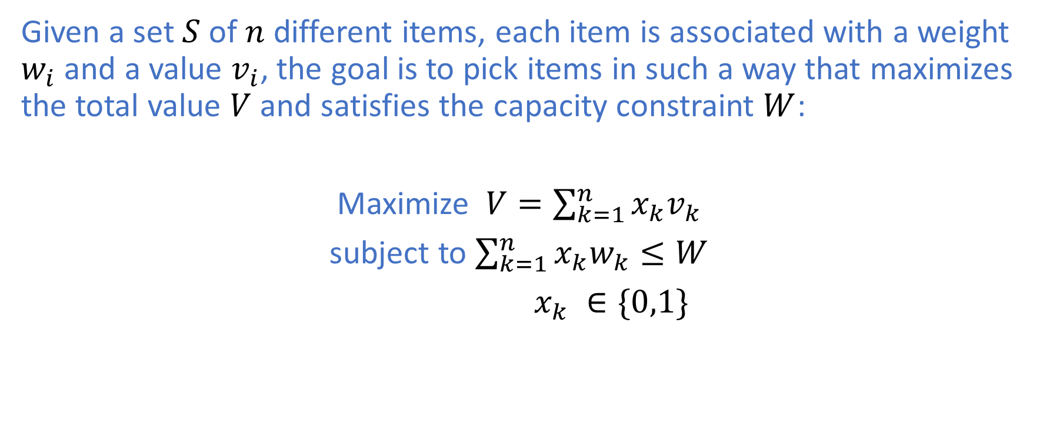
0/1 Knapsack Problem
Given a set $S$ of $n$ different items, each item is associated with a weight $w_{i}$ and a value $v_{i}$, the goal is to pick items in such a way that maximizes the total value $V$ and satisfies the capacity constraint $W$:
Maximize $V=\sum_{k=1}^{n}{x_{k}v_{k}}$
subject to $\sum_{k=1}^{n}{x_{k}w_{k}≤W}$
$x_{k} ∈\{0,1\}$

Slide 29
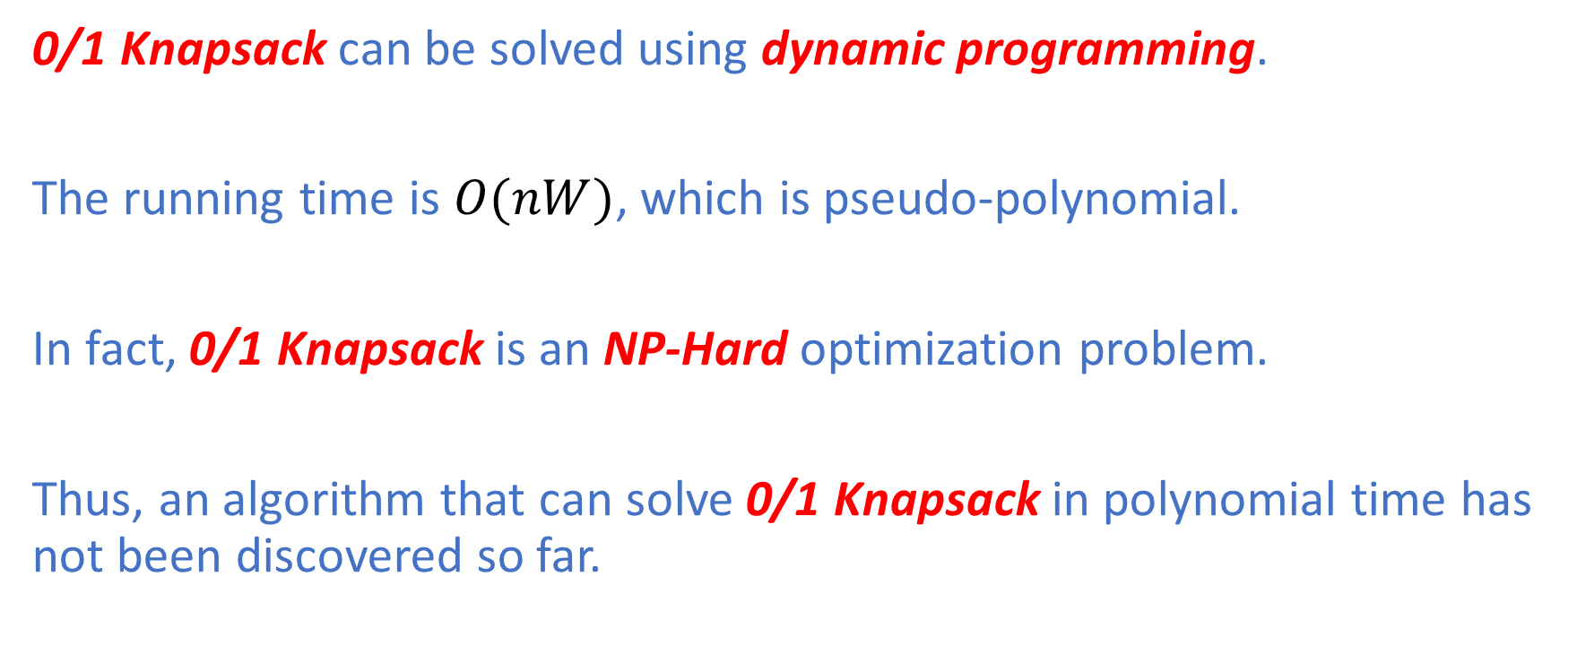
0/1 Knapsack Problem
0/1 Knapsack can be solved using dynamic programming.
The running time is $O(nW)$, which is pseudo-polynomial.
In fact, 0/1 Knapsack is an NP-Hard optimization problem.
Thus, an algorithm that can solve 0/1 Knapsack in polynomial time has not been discovered so far.

Slide 30
0/1 Knapsack Problem
To apply Branch & Bound, we need to associate a bound to each partial solution state.
There can be a number of schemes that can be used to compute bounds. Some schemes might provide tighter bounds than others.
Ones that provide tighter bounds can potentially prune more subtrees and hence be more efficient both in terms of running time and memory consumption.

Slide 31
0/1 Knapsack Problem: Example
 | weight | value | Value per unit weight
Item 1 | 3 | 21 | 7
Item 2 | 6 | 30 | 5
Item 3 | 5 | 15 | 3
Item 4 | 10 | 20 | 2
Item 5 | 8 | 8 | 1

Slide 32
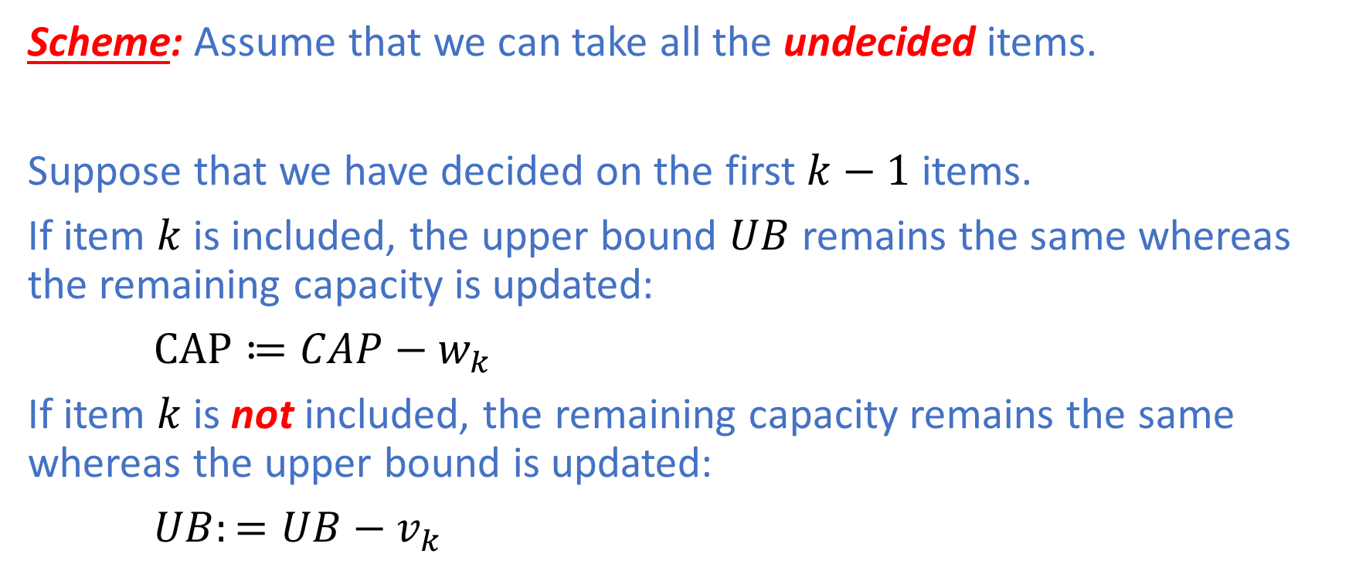
0/1 Knapsack Problem: Example
Scheme: Assume that we can take all the undecided items.
Suppose that we have decided on the first $k−1$ items.
If item $k$ is included, the upper bound $UB$ remains the same whereas the remaining capacity is updated:
$CAP≔CAP−w_{k}$
If item $k$ is not included, the remaining capacity remains the same whereas the upper bound is updated:
$UB:=UB−v_{k}$

Slide 33
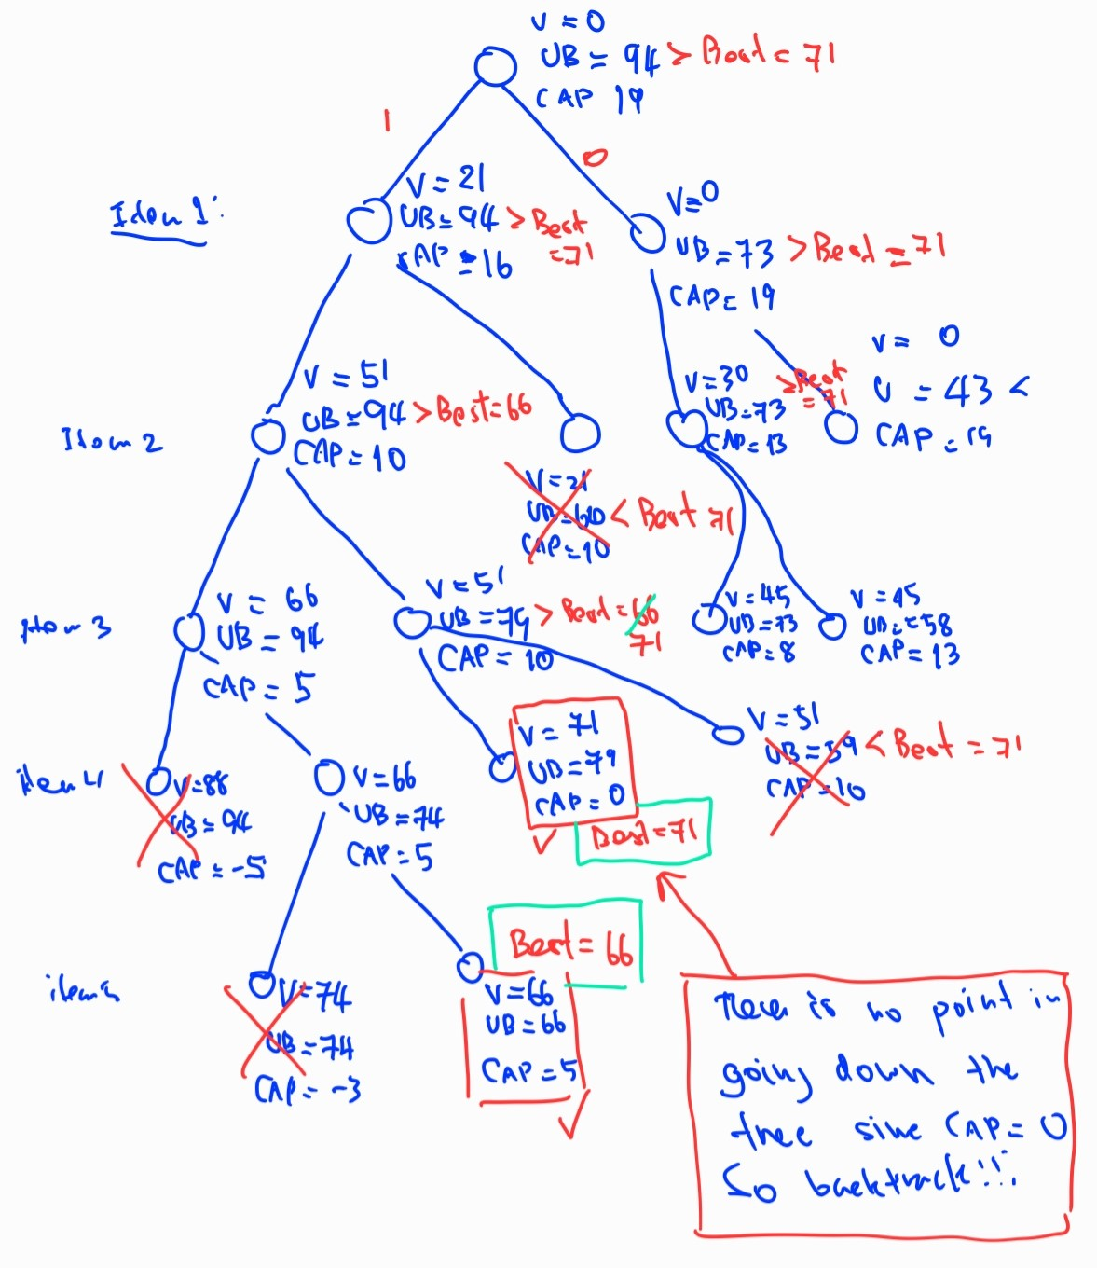
0/1 Knapsack Problem: Example

Slide 34
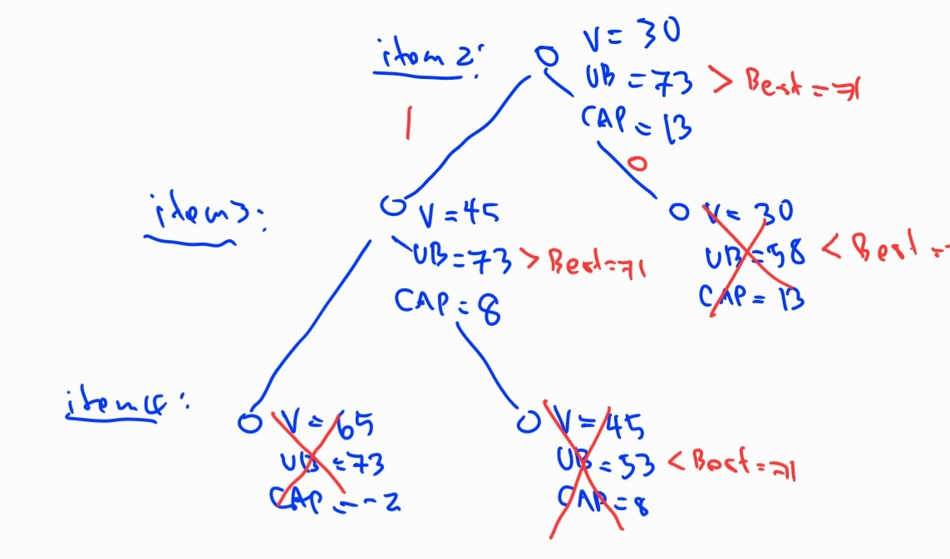
0/1 Knapsack Problem: Example

Slide 35
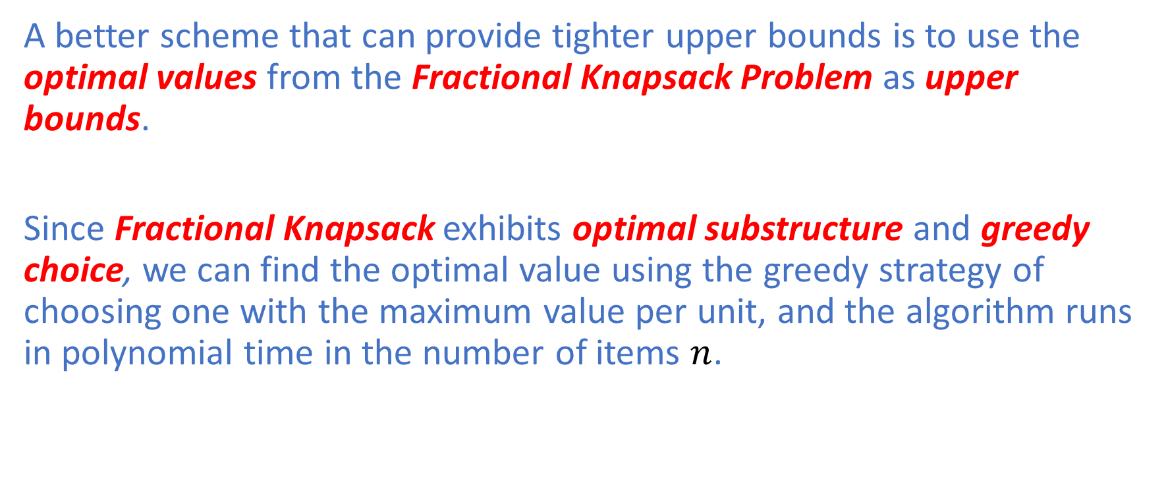
0/1 Knapsack Problem:
A better scheme that can provide tighter upper bounds is to use the optimal values from the Fractional Knapsack Problem as upper bounds.
Since Fractional Knapsack exhibits optimal substructure and greedy choice, we can find the optimal value using the greedy strategy of choosing one with the maximum value per unit, and the algorithm runs in polynomial time in the number of items $n$.

Slide 36
Branch & Bound : Lessons Learned
Branch & Bound can help prune subtrees that contain only solutions that cannot be better than the best solution found.
We decide whether to go down any given subtree by comparing the current best solution with the upper bound of the root vertex of that subtree.
Although there exists some computational overhead in computing an upper bound at each vertex, if that overhead is reasonably small relative to the number of solution states that can be potentially pruned, such an upper-bound scheme should be worth trying.

Slide 37
Summary
In this lecture, we covered the following state-space search techniques for solving NP-Hard and NP-complete problems:
Brute-Force Search
Backtracking
Branch & Bound
In the next lecture, we will cover Randomized Algorithms.

